Slide 1

AI Evolution

Slide 2

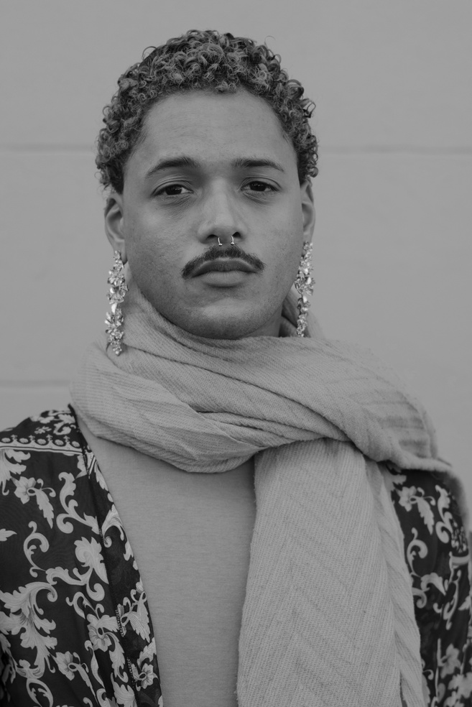



Our Management Team
Stella Ornelas
Chief Executive Officer
Bryan Cook
Chief Finance Officer
Blaise Martins
Briefly elaborate on
what you want to discuss.
Director
Carl Miller
Accountant
Drag and drop your photo or video! Click the sample photo or video and delete. Select yours from the uploads tab, drag, and then drop inside the frame!
Sadie Jones
Finance Manager
Back to Agenda

Slide 3

CONTENT
01
The Dawn of Artificial Intelligence
02
The Rise of Machine Learning
03
The Emergence of Deep Learning
04
AI Revolutionizing Industries
05
The Future of AI

Slide 4

The Dawn of Artificial Intelligence
- Early dreams of creating human-like intelligence - 9: Dartmouth Conference sparks the field of AI - Key figures: Alan Turing, John von Neumann, Claude Shannon

Slide 5
The Rise of Machine Learning
Machine Learning Algorithms: Supervised learning (classification, regression) Unsupervised learning (clustering, dimensionality reduction) Reinforcement learning Advancements in Deep Learning: Convolutional neural networks (CNNs) for image recognition Recurrent neural networks (RNNs) for language processing Transformers for natural language understanding Applications Across Industries: Healthcare (diagnosis, drug discovery) Finance (fraud detection, risk assessment) Manufacturing (predictive maintenance) Retail (recommendation engines, customer segmentation)

Slide 6
The Emergence of Deep Learning
- Neural networks: breakthrough in machine learning - Increased computational power and data availability - Applications in image recognition, natural language processing, and more

Slide 7
AI Revolutionizing Industries
Industries Impacted: - Healthcare: Early detection, personalized treatments - Manufacturing: Automated processes, increased productivity - Finance: Fraud detection, risk management - Retail: Personalized recommendations, optimized inventory Applications: - Smart cities: Traffic management, energy optimization - Agriculture: Crop monitoring, yield optimization - Cybersecurity: Enhanced threat detection and protection - Education: Personalized learning, virtual tutors

Slide 8
The Future of AI
Balancing technological advancements with ethical principles Identifying and mitigating potential risks Harnessing AI's power for societal progress Exploring the vast possibilities and untapped potential Shaping a responsible and inclusive future for AI

Slide 9

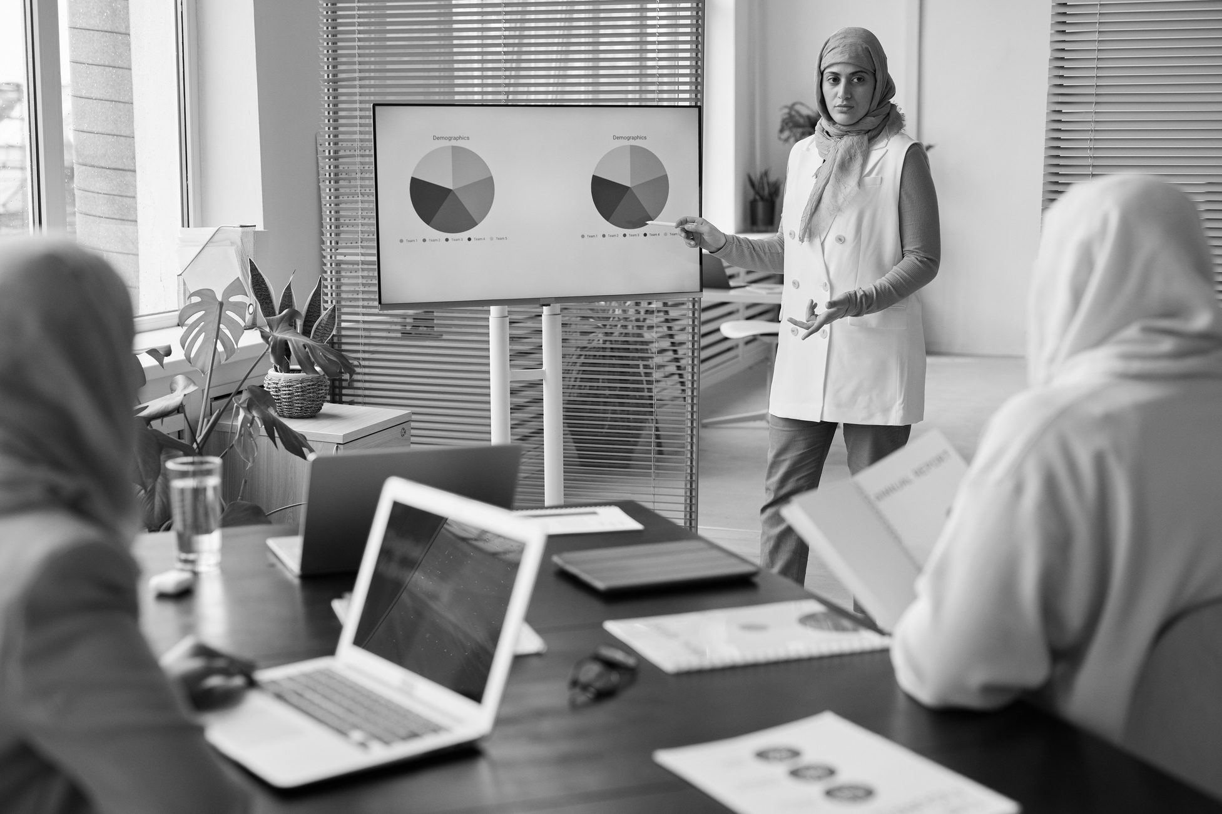


THANK YOU
Drag and drop your photo or video! Click the sample photo or video and delete. Select yours from the uploads tab, drag, and then drop inside the frame!

